Slide 1
Fashion project
By Andrew Heinze

Slide 2
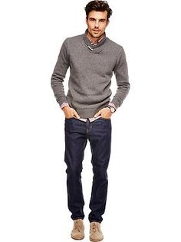
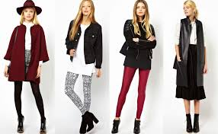
What is fashionable in your country? What clothes are thought as fashionable/modern?
The modern or the fashionable clothing in our countries would be somethings between something very nice and something casual. For men it could be something like sweatpants and a t-shirt or a shirt and tie. For women it would be something like a casual skirt. They would also wear tights and a t-shirt.

Slide 3
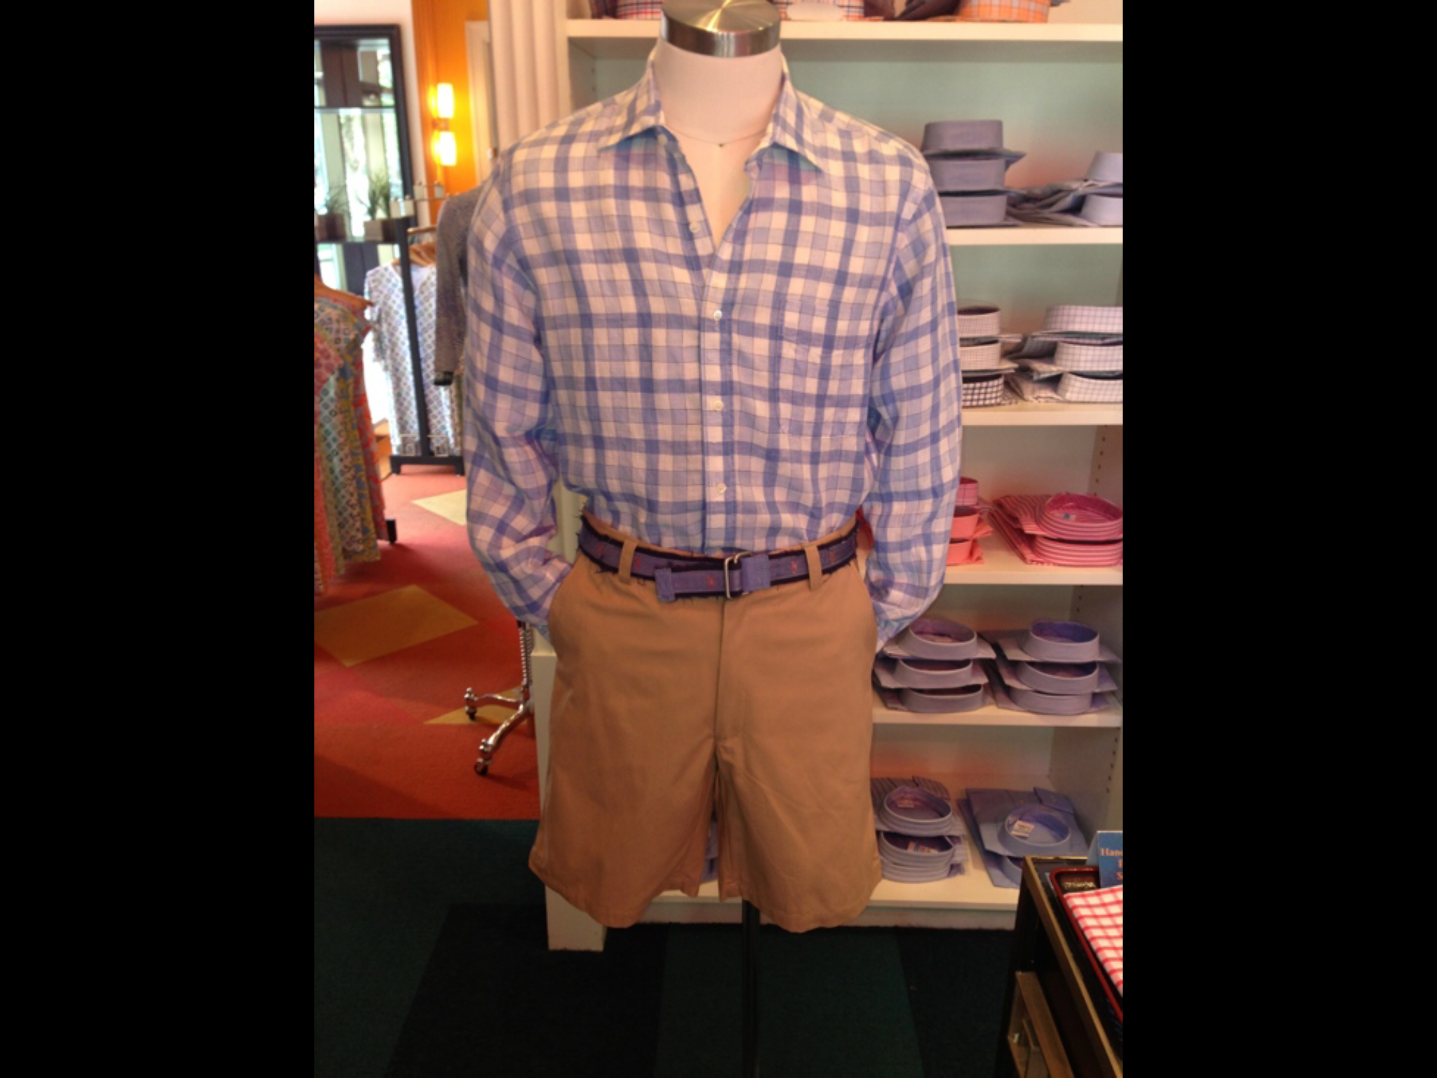
Do you wear a school uniform? What parts (clothes) does it consist of?
We do not have a school uniform, but we do have a dress code. We have to wear a collared shirt, khakis or khaki shorts, and we must tuck our shirts in, and we can wear sweatshirts.

Slide 4
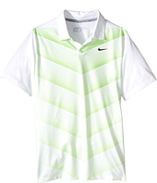
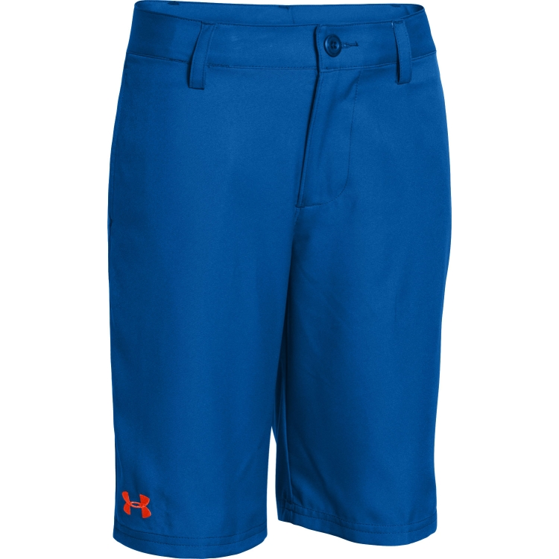
What clothes do you wear on different special occasions (holidays, parties, ceremonies)?
When we go to these events we would usually wear nicer clothing. On important holidays my parents has me wear nice clothing. If we were going to a party we would wear casual clothes.

Slide 5
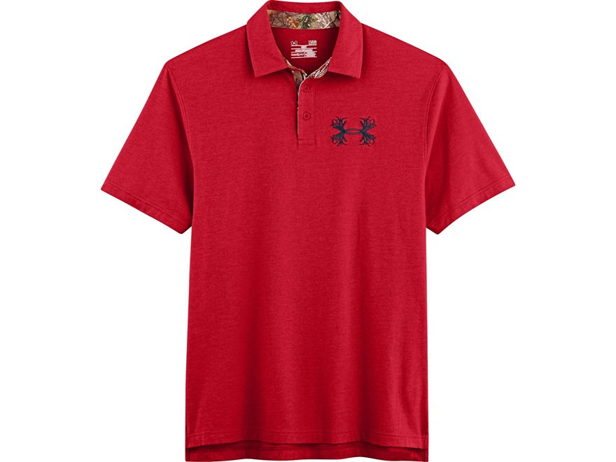
Where do you buy your clothes? What are your favourite shops?
Most kids my age (12) will either buy clothes that are causal and will wear on the weekends. Other times they will buy clothes for school. Most kids but their clothes at, under armor and Nike. For school kids will but from gap and old navy but they will still shop at under armor and Nike.

Slide 6
THE END

